Slide 1
Skilling Architect's LXS Desktop App Usability Study
1/3/2022
UX Analysis Team
Angeliki Manta Davis Developer
Cameron Coder

Slide 2
Table of Contents
Section 1 Study Details
Section 2 Themes
Section 3 Insights & Recommendations

Slide 3
Study Details

Slide 4
Project Background
We are creating the Skilling’s Architect desktop app for learners attract and retain customers in our learning experience system. We noticed that our competitors offer dedicated desktop apps for their customers to build their skilling growth through, and they have been very successful. We want to create a product that can compete in the market, improve sales, and increase customer satisfaction.

Slide 5
Study Details
Research Questions
Participants
Methodology
How long does it take for a user to login and create profile
Are users able to successfully find the learning path that fits their needs?
Are users able to successfully navigate in the learning path?
Are there any parts of the skilling Architect process where users are getting stuck?
What can we learn from the steps users took to finally discover and start to navigate in the learning path?
5 participants
Participants between the ages of 18-62 who reside in metropolitan and suburb areas. Participants attend a course out at least once per 2 weeks..
25-30 minutes
Greece, remote
Unmoderated usability study
Users were asked to log in - find and “Complete” a learning path by navigating and finding all tasks, on a low-fidelity prototype

Slide 6
First Prototype

Slide 7
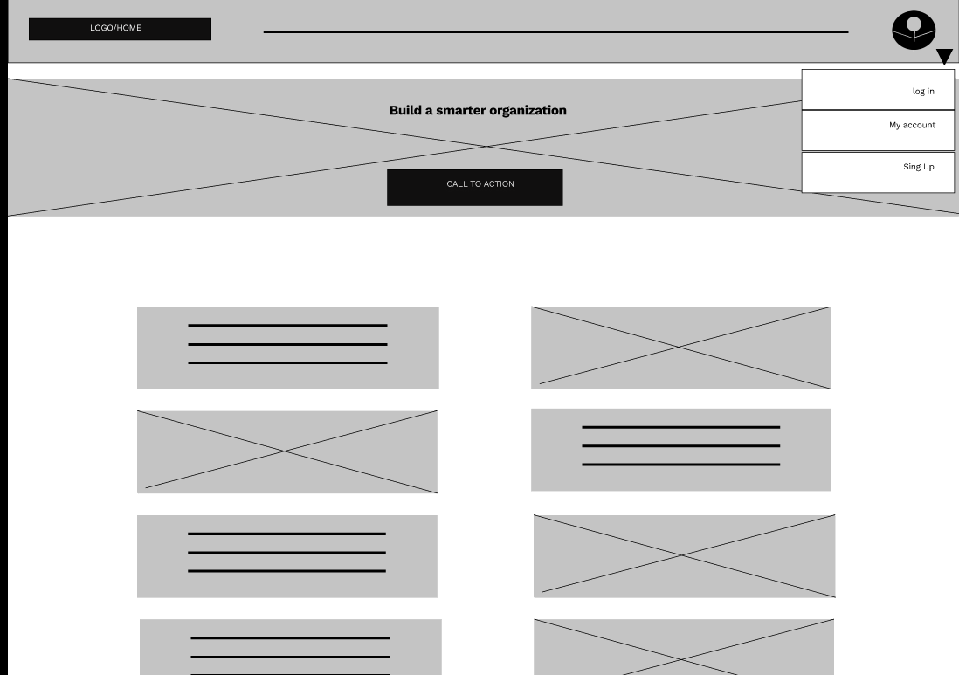
First Prototype Tested
The low-fidelity desktop app prototype for Skilling Architect was tested. The first prototype can be viewed here.

Slide 8
Themes

Slide 9
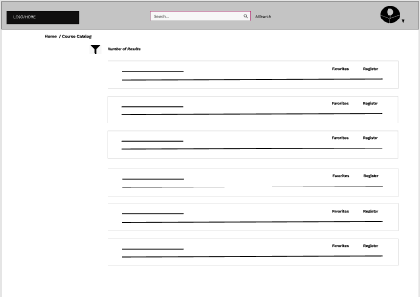
People want to have quick structured results according their search
Supporting evidence from the usability study.
5 out of 5 total participants said they found the results confusing and could not see any filter..
3 out of 5 total participants found the Ai personalized search in order to have better results quickly
“I like the profile feature, but it is frustrating not to be able apply filters to the search results.”
— Alan East, pizza consumer from Koukaki, Athens
Before

Slide 10
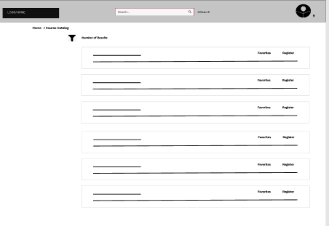
People want to create a library with courses finished or for future use.
Supporting evidence from the usability study.
4 out of 5 total participants said they they could not understand the use of favorites and register.
3 of those participants only registered so the course was not added to their library.
“I do not understand the “favorites” feature and what about register?.”
— Noemi Hirsch, employee in company Serres Greece
Before

Slide 11
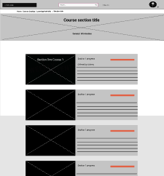
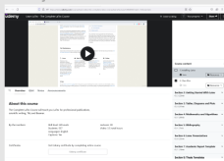
People want a easy way to navigate in the learning path
Supporting evidence from the usability study.
3 out of 5 Where frustrated on how to navigate and to find all tasks.
2 out of 3 could not complete the learning path.
“I am redirected to another platform so I thought that my path was there. Never thought there was more in the first platform.”
— Anna Lim, assistant in cs support, Lamia Greece
External links & content at bottom of the page
Before

Slide 12
Insights & Recommendations

Slide 13
Research insights
Search results
Customization options
Paths Navigation
Users need a way search and have a quick overview of what they get.
Users need to customize their library and have a clear understanding how registration works
Users need a way to understand what to do, how and where the content is.

Slide 14
Recommendations
Add a obvious filter tabs with options. Make the AI search visible and more understandable & rename to “personalized search”
Add obvious easy to understand actions “add to library “ and register.
Add a tutorial for learning path and easy to understand overview of each section.

Slide 15
Second Prototype

Slide 16
Second Prototype Tested
The low-fidelity desktop app prototype for Skilling Architect was tested. The second prototype can be viewed here.

Slide 17
Themes

Slide 18
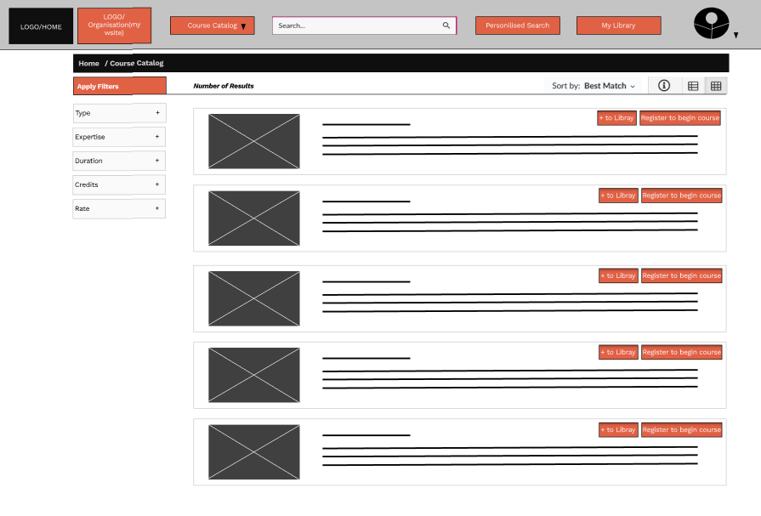
People want to have quick structured results according their search
Supporting evidence from the usability study.
5 out of 5 total participants said they found the results confusing and could not see any filter..
3 out of 5 total participants found the Ai personalized search in order to have better results quickly
“I like the profile feature, but it is frustrating not to be able apply filters to the search results.”
— Alan East, pizza consumer from Koukaki, Athens
After

Slide 19
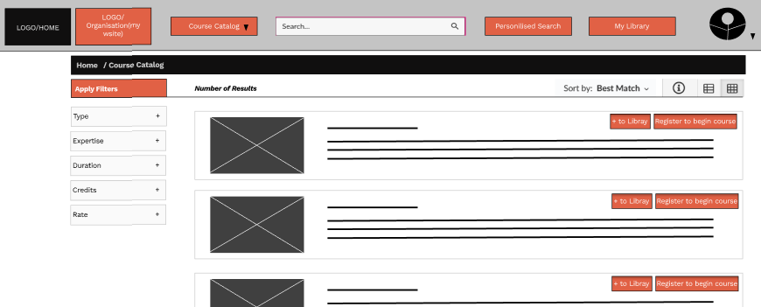
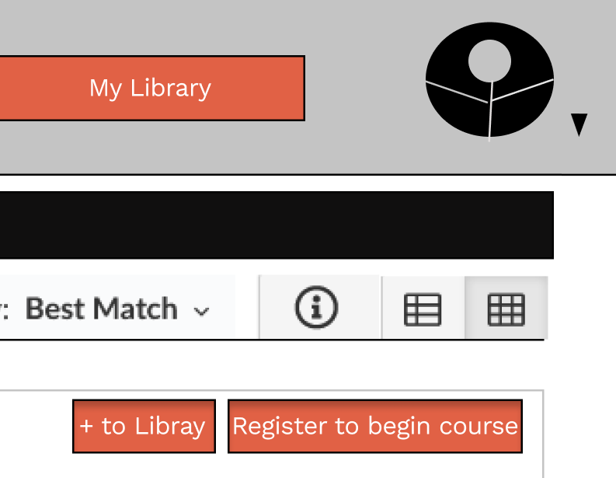
People want to create a library with courses finished or for future use.
Supporting evidence from the usability study.
4 out of 5 total participants said they they could not understand the use of favorites and register.
3 of those participants only registered so the course was not added to their library.
“I do not understand the “favorites” feature and what about register?.”
— Noemi Hirsch, employee in company Serres Greece
After

Slide 20
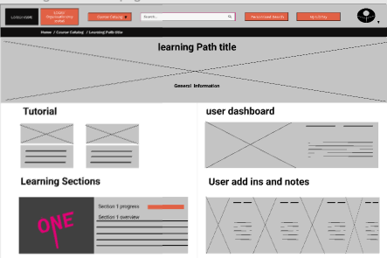
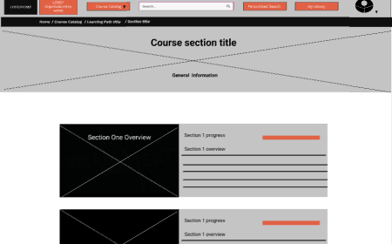
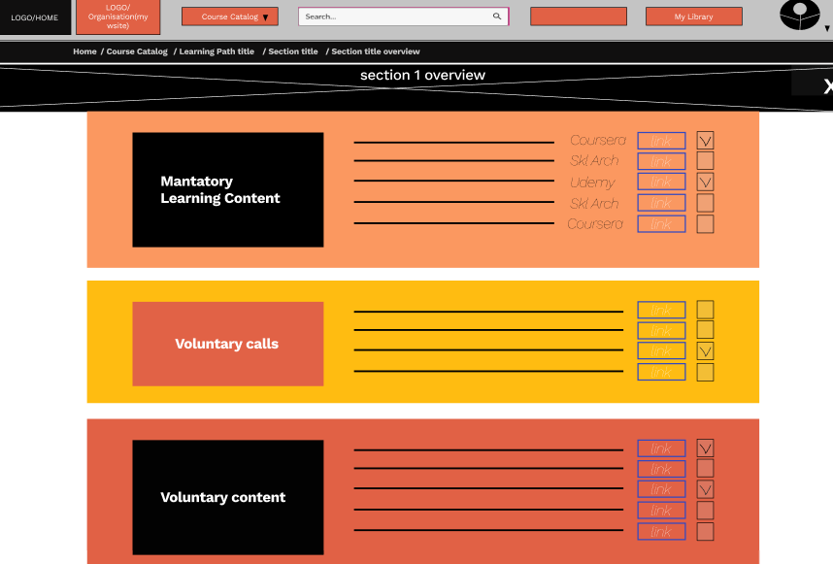
People want a easy way to navigate in the learning path
Supporting evidence from the usability study.
3 out of 5 Where frustrated on how to navigate and to find all tasks.
2 out of 3 could not complete the learning path.
“I am redirected to another platform so I thought that my path was there. Never thought there was more in the first platform.”
— Anna Lim, assistant in cs support, Lamia Greece
Tutorial & detailed overview as guides
After

Slide 21
Next steps

Slide 22
Next steps
1
2
3
Continue to refine each screen with the user in mind
Better learning Path customization. Give user more options
Give User flexibility in search and customize his own library

Slide 23
Acknowledgements

Slide 24
Acknowledgements
● Thank you to all 5 participants who shared their time, views and feedback to help improve our learning app..
● Thanks to my team members who have been a great asset and who have invested their time and attention to this project.
● Thanks to our stakeholders who have been open to hearing our findings and recommendations for the app

Slide 25
Thank you!

